Slide 1
802.15.4 Project
The Northernites
Sam Weismuller, SangRyul “Eric” Pae, Jay Cordaro
MAS 2023 Students UC San Diego

Slide 2
Progress
Selected RF front end
Tx and Rx MATLAB simulations
Initial SPI interface implementation for Teensy and FPGA
Tx demonstration of CW from RF front end

Slide 3
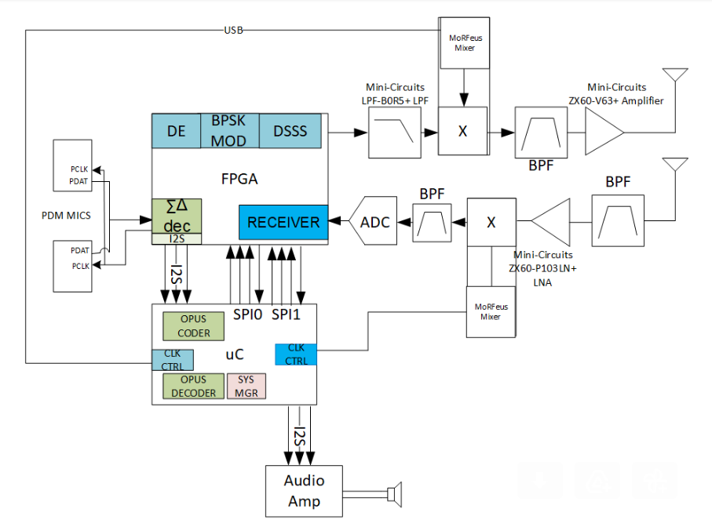
Block Diagram

Slide 4
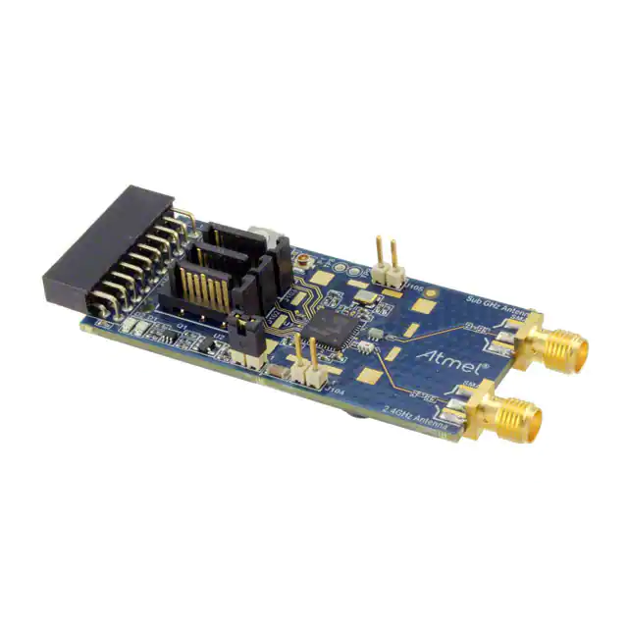
ATREB215-XPRO-A
Part for RF Front End
IQ radio for 909 MHz band
Controllable via SPI and LVDS

Slide 5
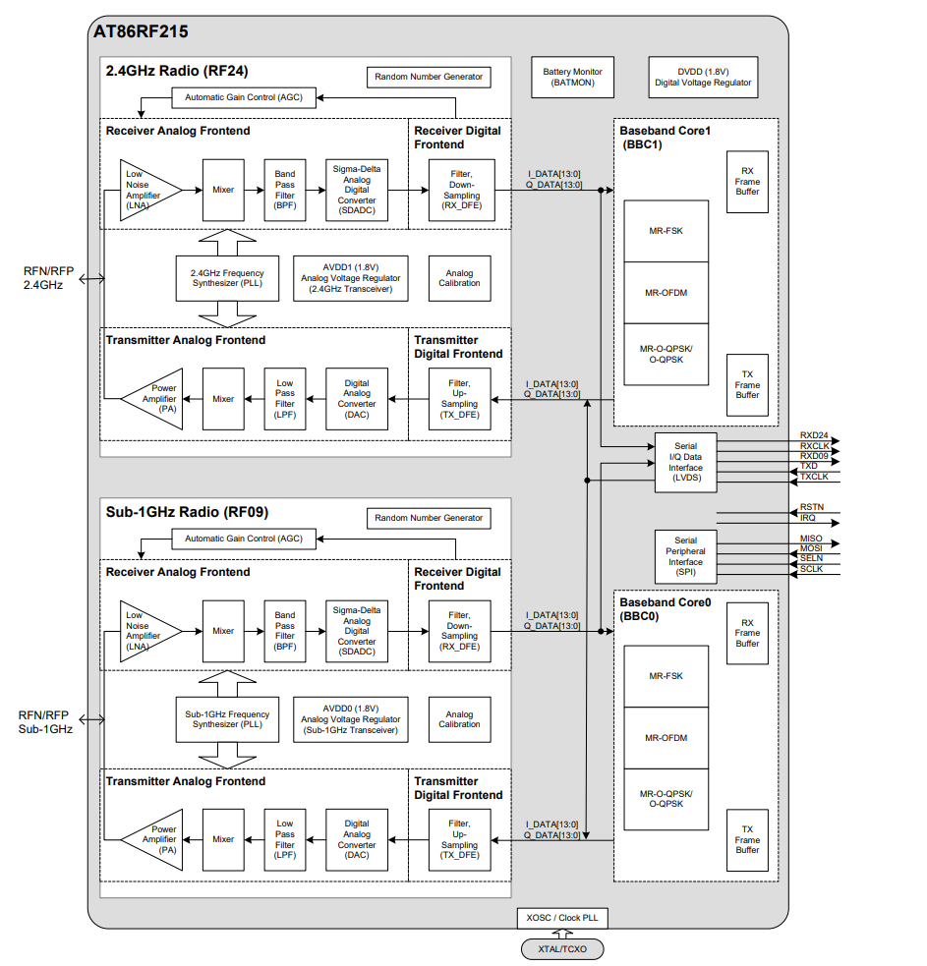
RF Front End Block Diagram

Slide 6
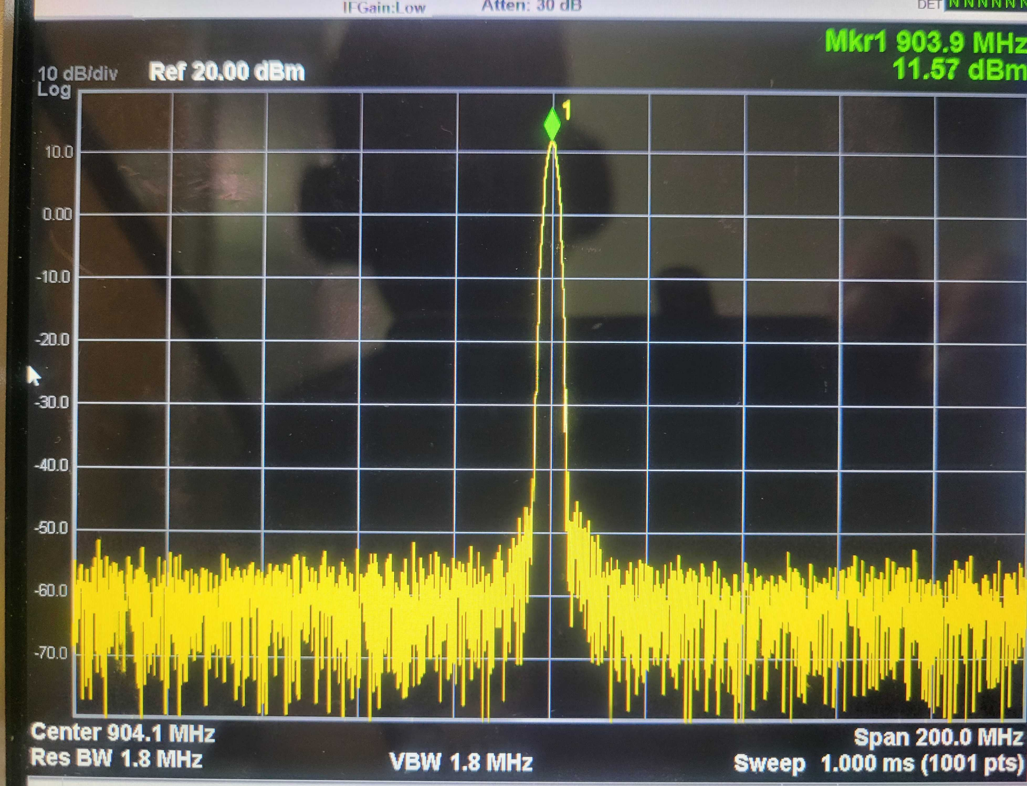
RF Front End CW Demo

Slide 7
SPI Interfaces
Two SPI interfaces
Teensy to FPGA
Teensy to RF Front End
The RF Front End SPI interface is specified by the documentation
Teensy and FPGA SPI interfaces were implemented by us

Slide 8
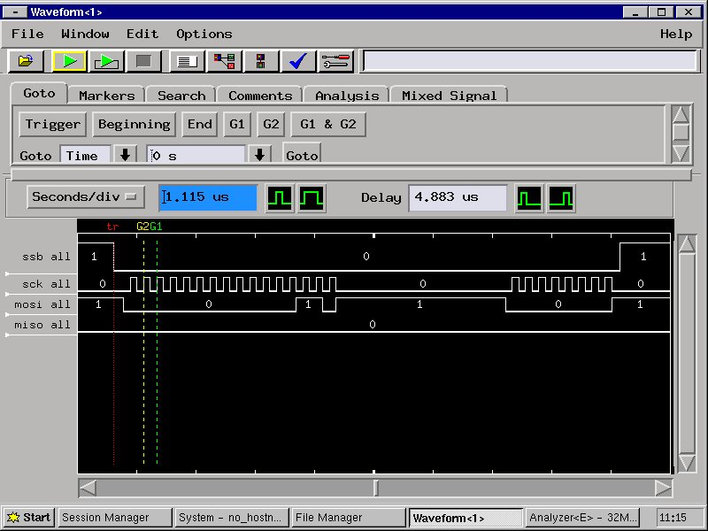
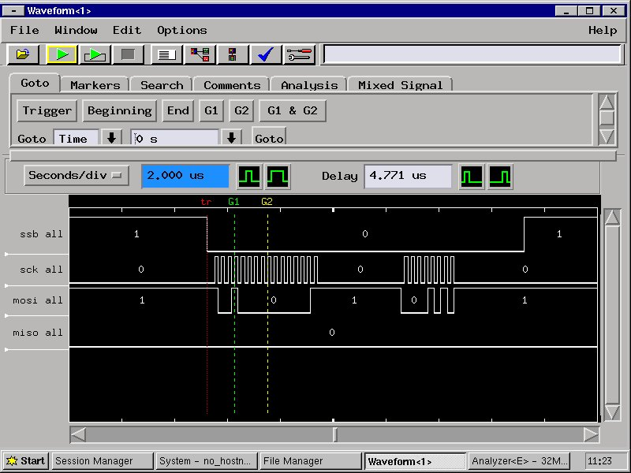
SPI Interface Demo

Slide 9
Tx Simulation
Generates PHY preamble and an example payload
Generates chip sequence for each input bit
Modulates chip sequence with pulse-shaped BPSK
Displays eye diagram and spectrum

Slide 10
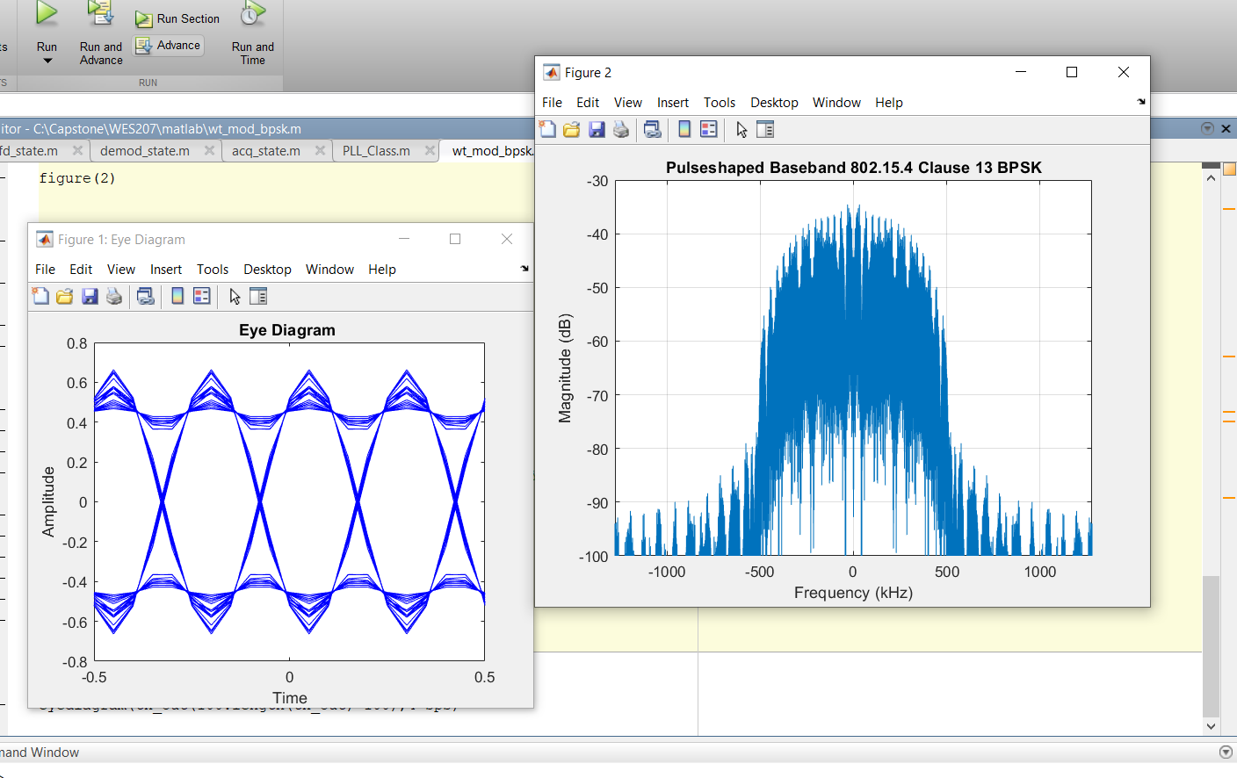
Tx Simulation Demo

Slide 11
Rx Simulation
Adjustable SNR, phase, and frequency error
Detects the start of the preamble with a matched filter on the chip sequence
Obtains time estimate and initial frequency estimate
Looks at each following symbol for the sequence that ends the preamble
Reads the payload length from the PHY header
Outputs demodulated bits after the header
Phase/frequency error is corrected with a PLL
Prints number of bit errors, matched filter outputs, and PLL estimates

Slide 12
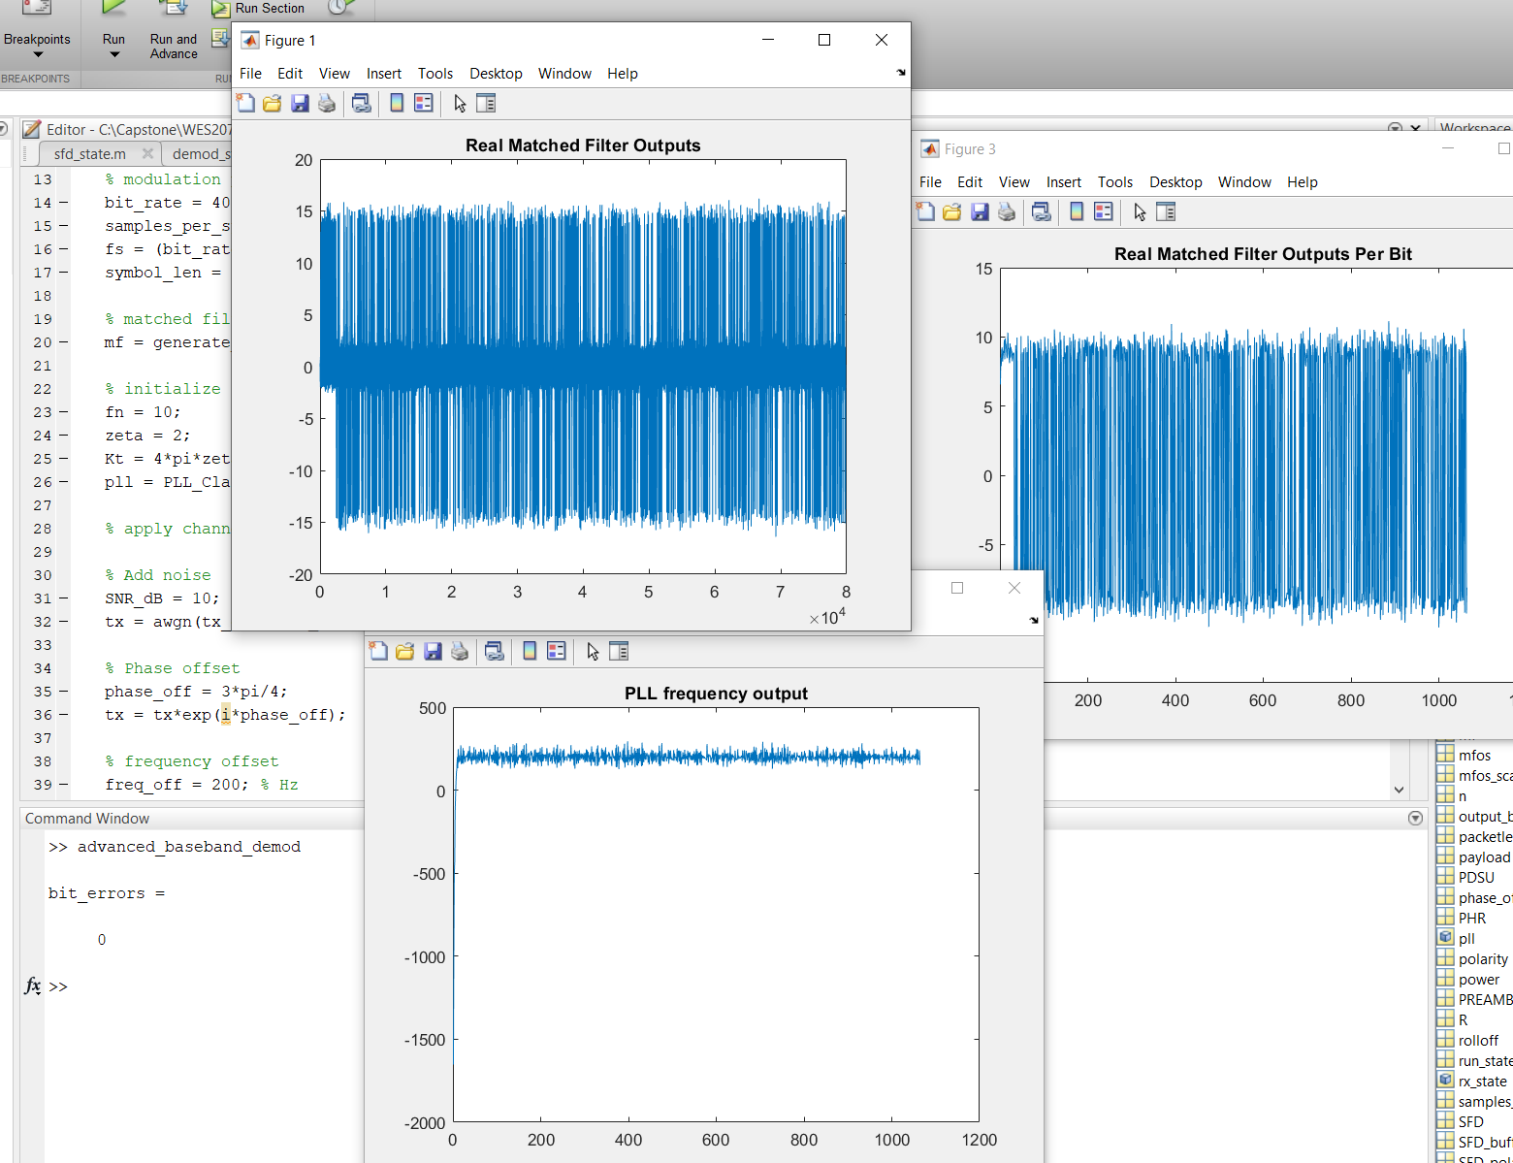
Rx Simulation Demo- High SNR

Slide 13
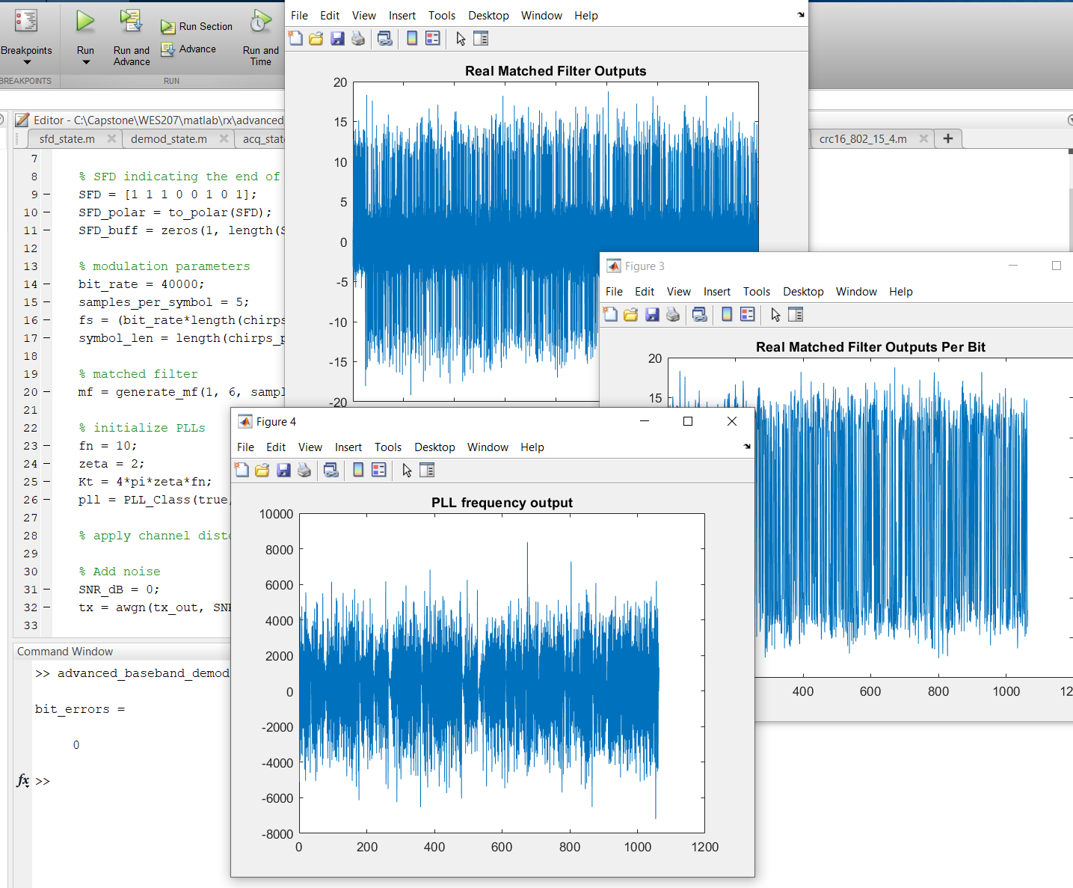
Rx Simulation Demo- Low SNR

Slide 14
Future Work
Had more difficulty than expected with getting the FPGA setup
Will need to cut unnecessary features:
Will switch from real-time to a file-based transceiver
Will remove speaker and microphone
Will use one SPI interface to communicate with Teensy instead of two
For next meeting, focus will be to complete Microcontroller and demonstrate BPSK transmit on the RF front end

Slide 15
802.15.4 Project RF Front End components test results

Slide 16
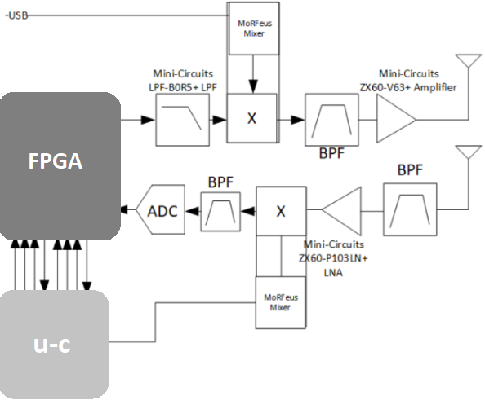
Block Diagram

Slide 17
RX

Slide 18
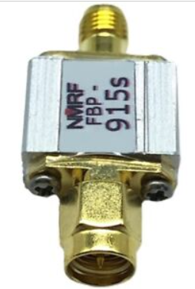
Rx RF BPF-1
FBP-915s
Impedance:50 ohms
Center frequency:915MHz
Passband:902～928MHz
Band Insertion Loss:<2.5 dB
Out-of-band isolation: > 40 dB @ 815 MHz and 1015 MHz
Maximum load power:300 mW (25 dBm)
Interface:SMA-M, SMA-F

Slide 19
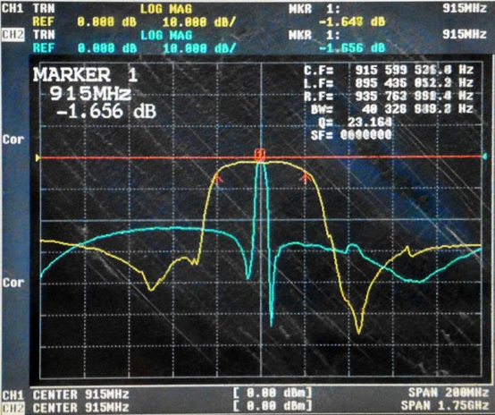
Rx RF BPF
FBP-915s
Impedance:50 ohms
Center frequency:915MHz
Passband:902～928MHz
Band Insertion Loss:1.7 dB
Out-of-band isolation: > 40 dB @ 815 MHz and 1015 MHz
Maximum load power:300 mW (25 dBm)
Interface:SMA-M, SMA-F

Slide 20
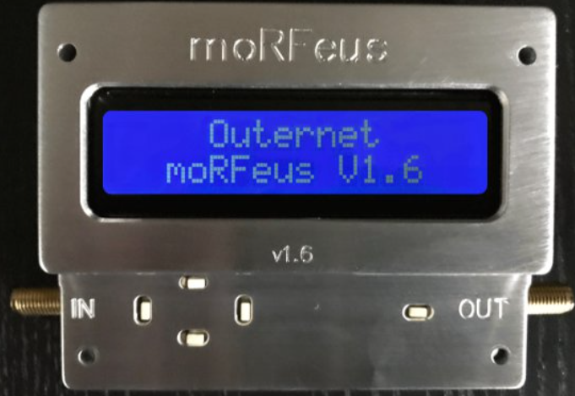
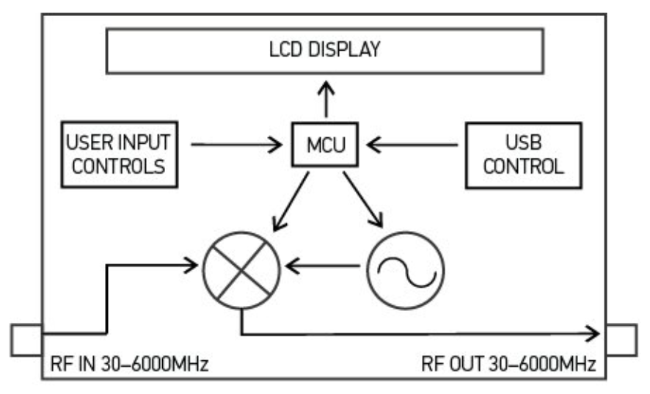
Mixer + PLL + TCXO
moRFeus
RF input frequency: 30 MHz – 6 GHz
RF output frequency: 30 MHz – 6 GHz
LO frequency: 85 MHz – 5400 MHz
Fractional-N synthesizer
LO step size: 1.5 – 3 Hz*
Up/Down conversion both are OK
(*alternative option for 2nd unit: )
( Mini-Circuits ZAD-2 mixer + SigGen with ref sync)
(* UCSD SigGen )

Slide 21
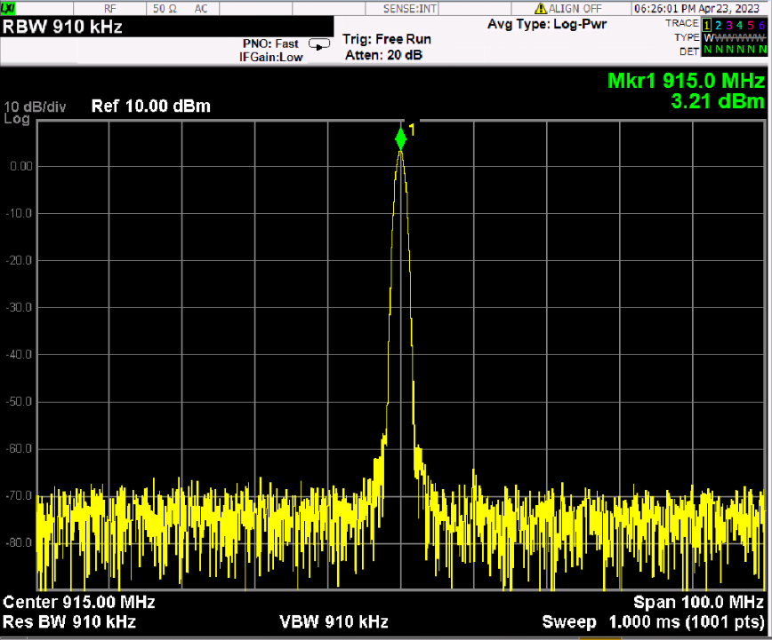
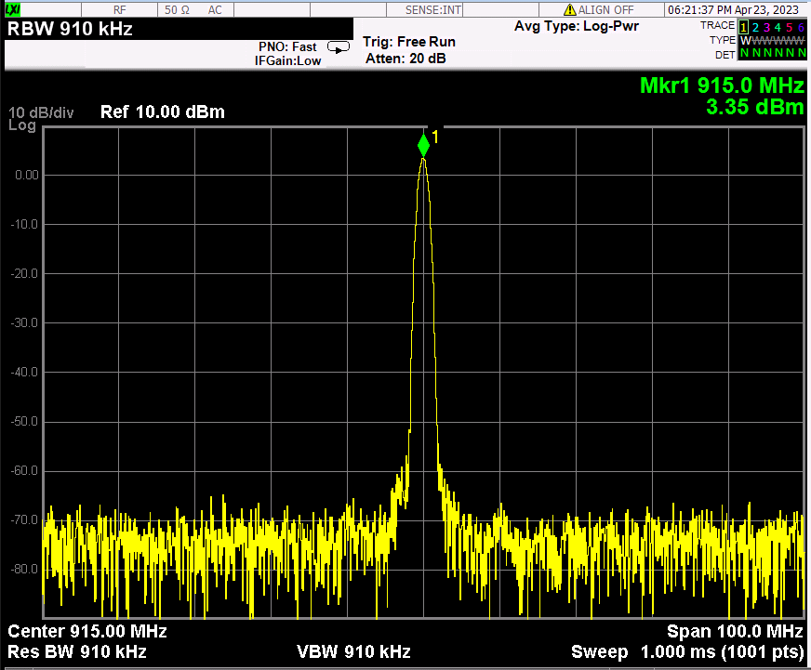
Generator mode
<moRFeus A current7>
<moRFeus B current7>

Slide 22
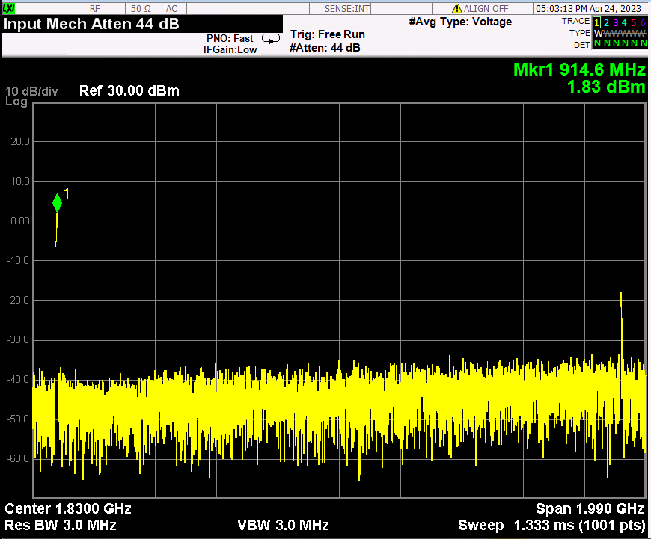
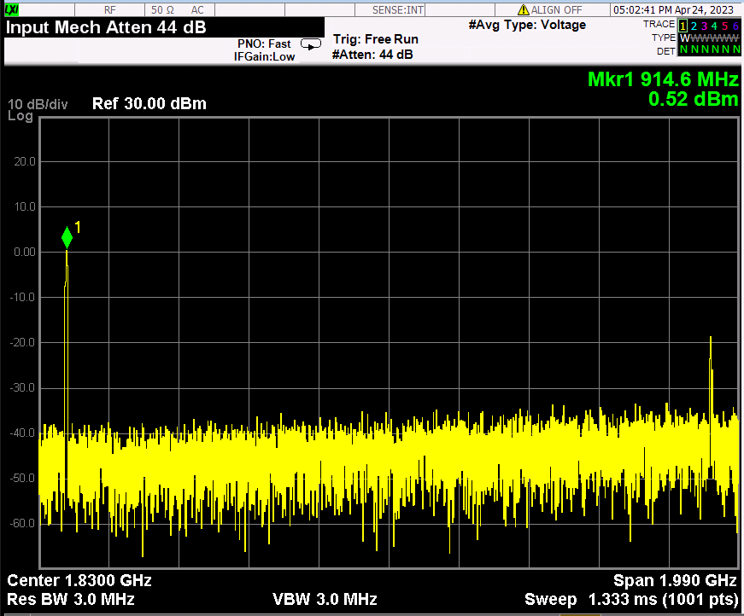
Generator mode
<moRFeus B current6>
<moRFeus B current5>

Slide 23
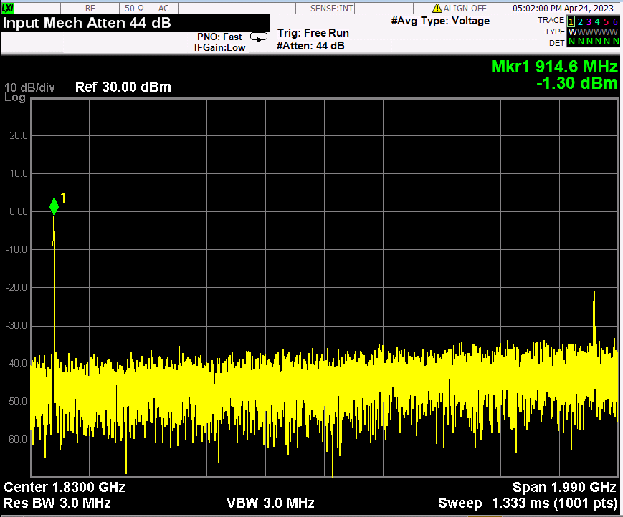
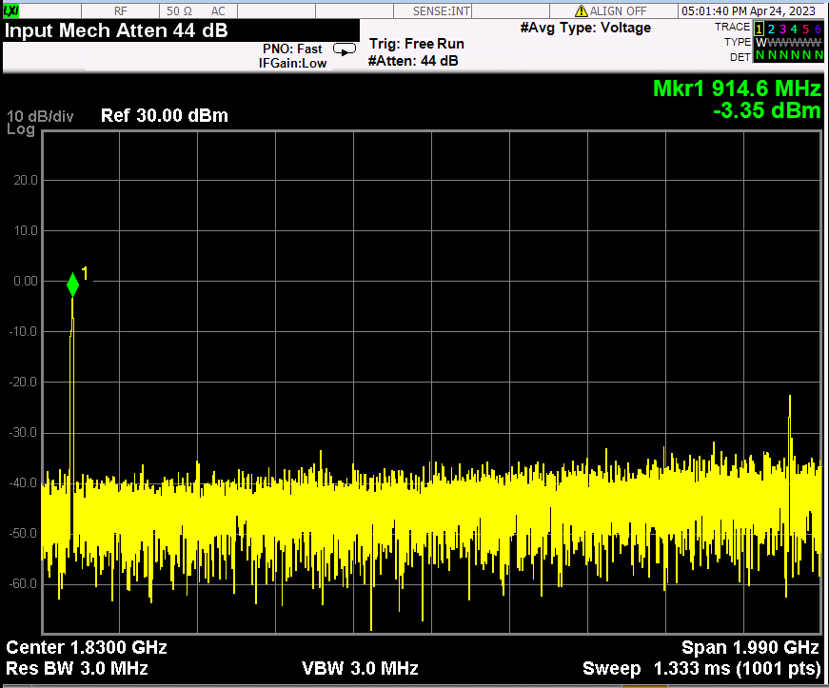
Generator mode
<moRFeus B current4>
<moRFeus B current3>

Slide 24
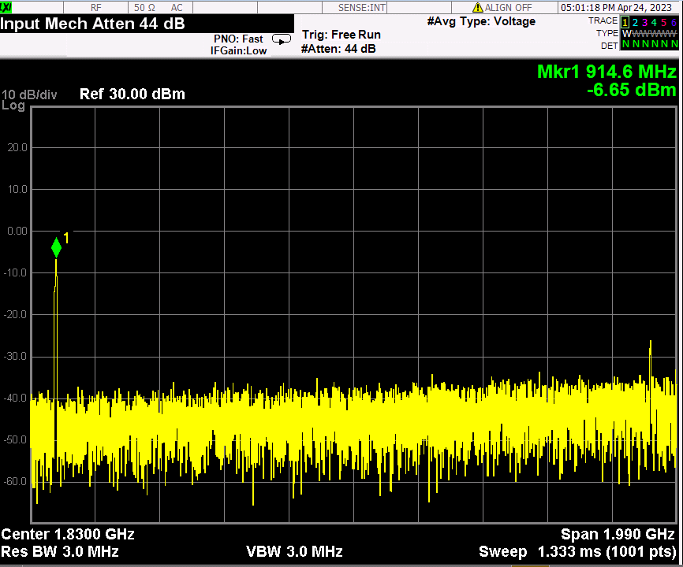
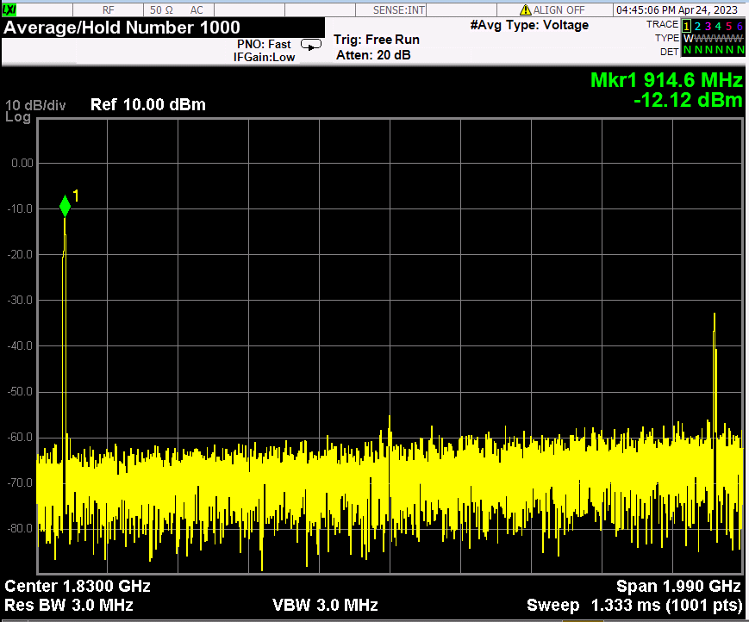
Generator mode
<moRFeus B current2>
<moRFeus B current1>

Slide 25
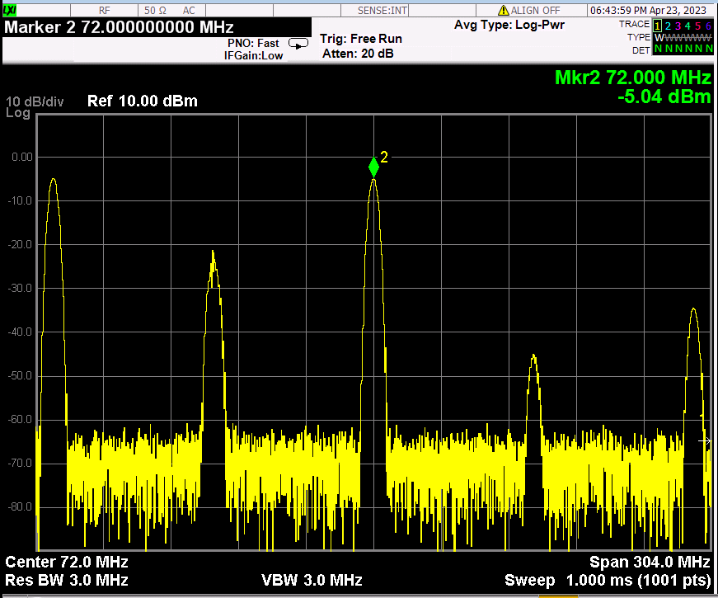
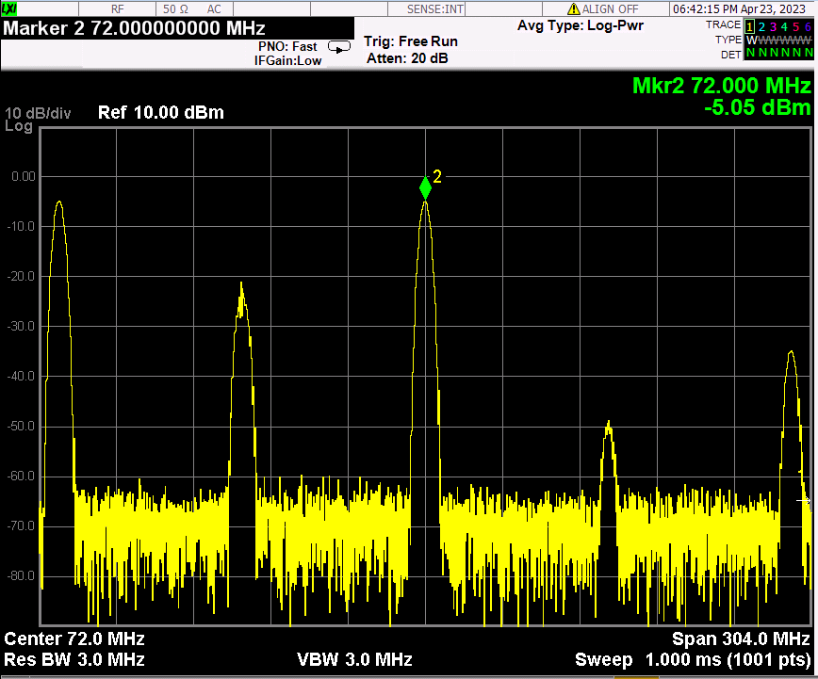
Mixer mode
morFeus B:Generator, 915MHz
morFeus A:mixer, LO:843, current:7
morFeus B:Generator, 915MHz
morFeus A:mixer, LO:987, current:7

Slide 26
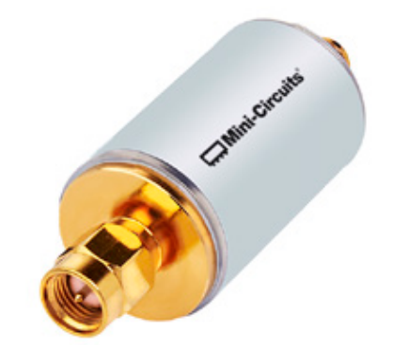
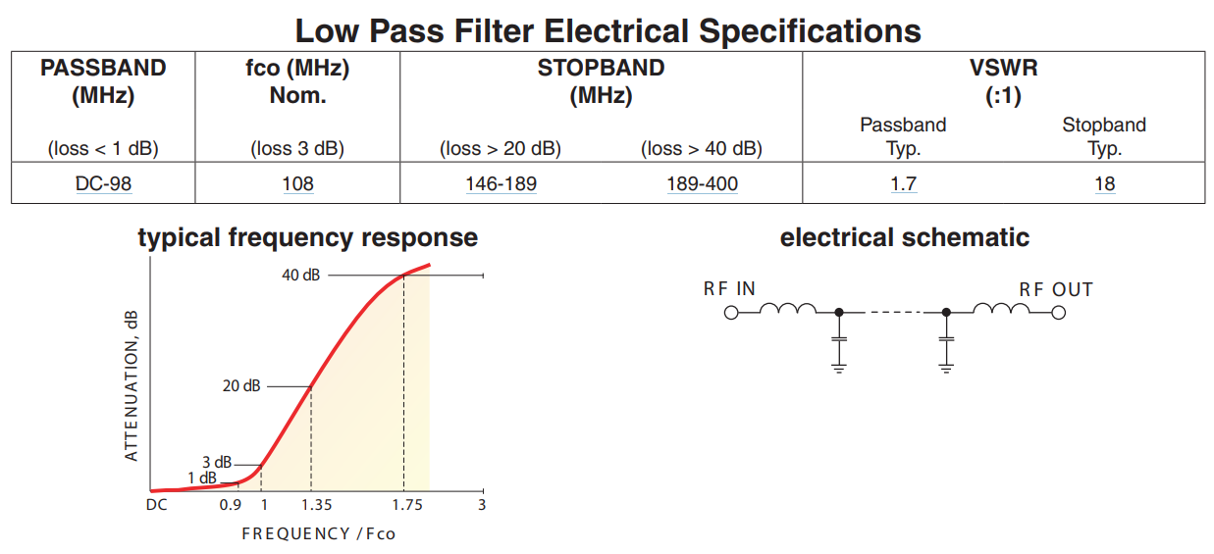
Rx IF filter
SLP100+
Pass band: DC~98MHz,
IL:0.58 @900MHz
2fo rejection : 48dB,
3fo rejection : ~75dB

Slide 27
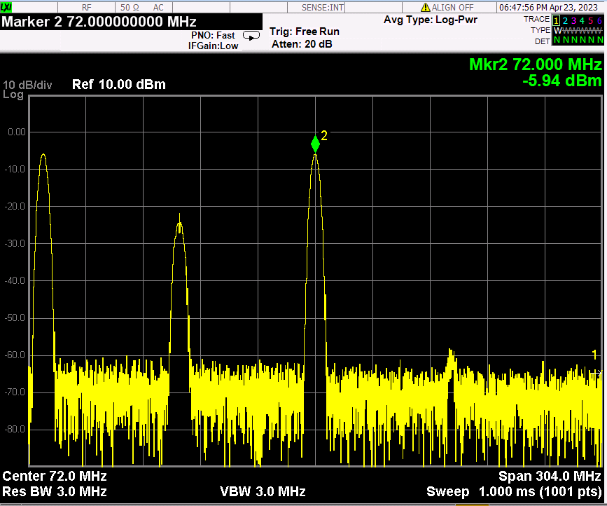
Mixer+ IF LPF(SLP100+)
morFeus B:Generator, 915MHz, morFeus A:mixer, LO:843, current:7

Slide 28
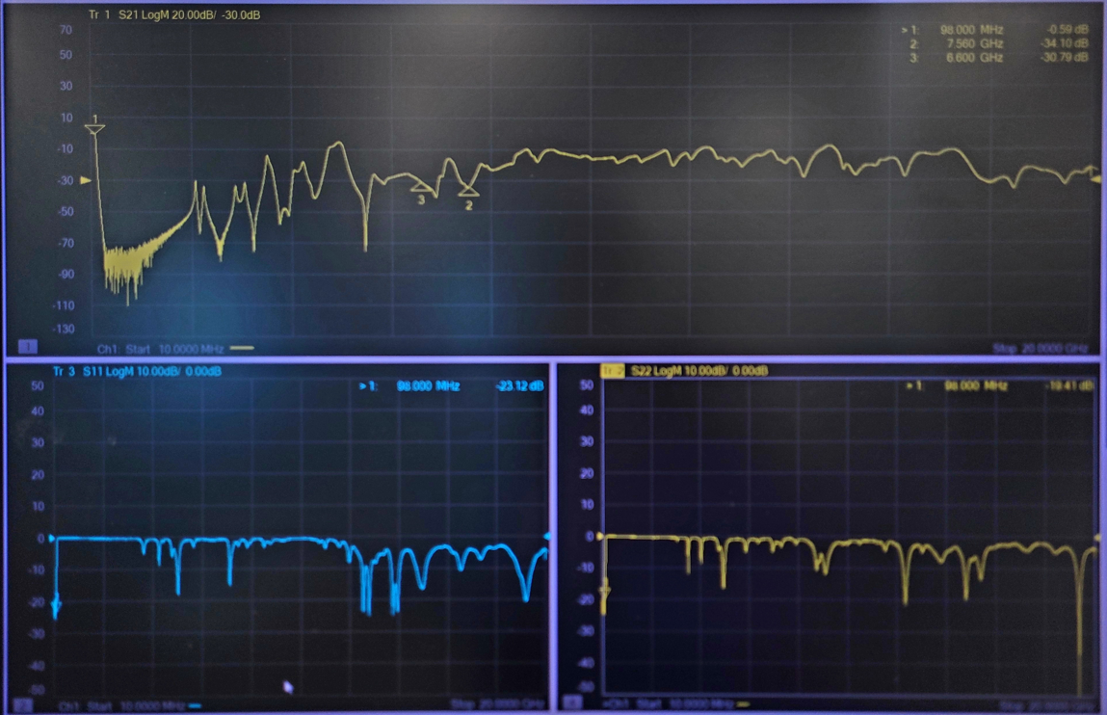
IF LPF(SLP100+) wide span

Slide 29
TX

Slide 30
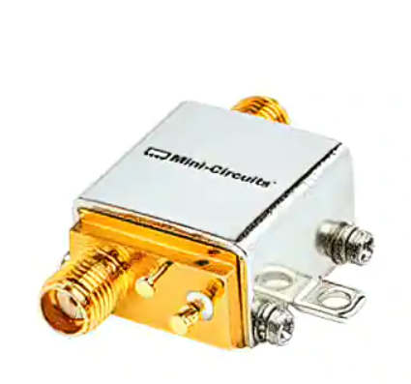
PA
ZX60-V63+
Frequency: 50MHz ~ 6GHz
P1dB : 18.5dBm
Gain : 15.4dB
Noise Figure : 4.3dB
Voltage - Supply : 4.8V ~ 5.2V
Current - Supply : 69mA
SMA Connectors

Slide 31
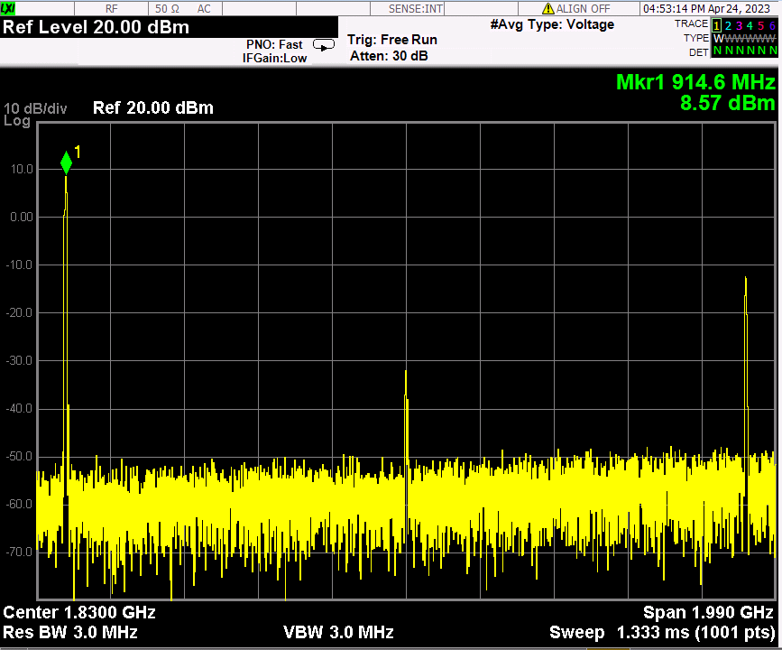
moRFeus generator(-12.12dBm)+ PA(ZX60-V63+)

Slide 32
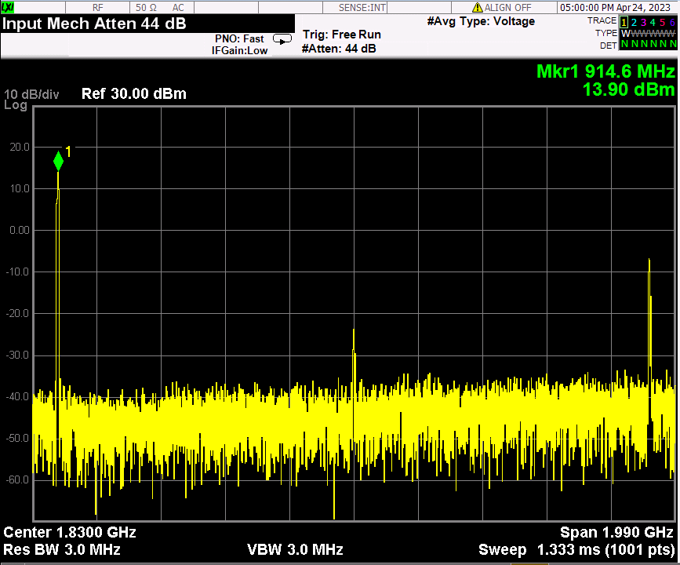
moRFeus generator(-6.65dBm)+ PA(ZX60-V63+)

Slide 33
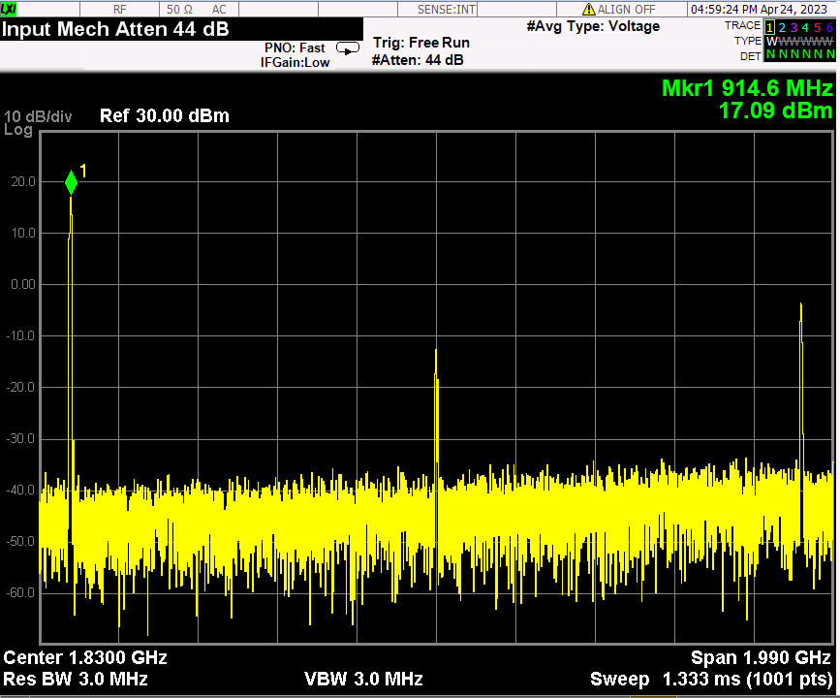
moRFeus generator(-3.35dBm)+ PA(ZX60-V63+)

Slide 34
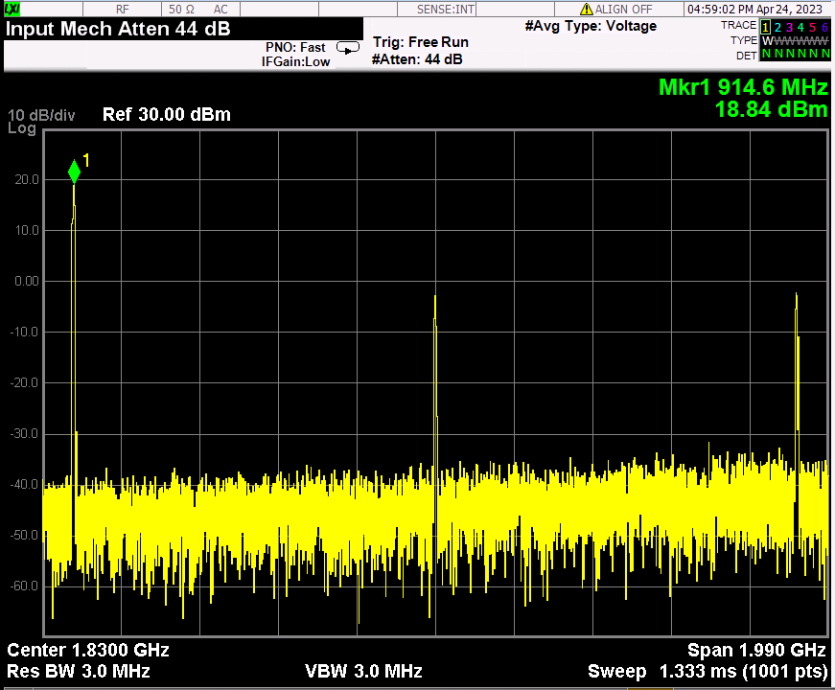
moRFeus generator(-1.30dBm)+ PA(ZX60-V63+)

Slide 35
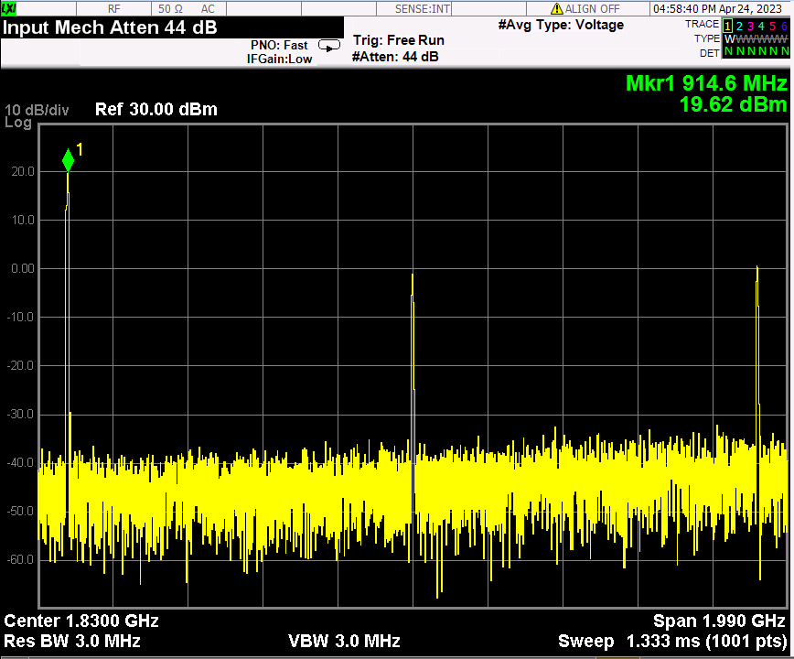
moRFeus generator(0.52dBm)+ PA(ZX60-V63+)

Slide 36
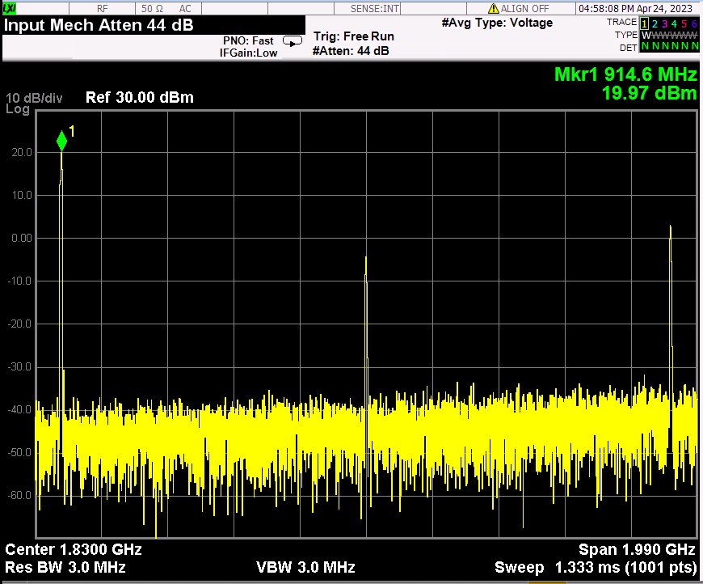
moRFeus generator(1.83dBm)+ PA(ZX60-V63+)

Slide 37
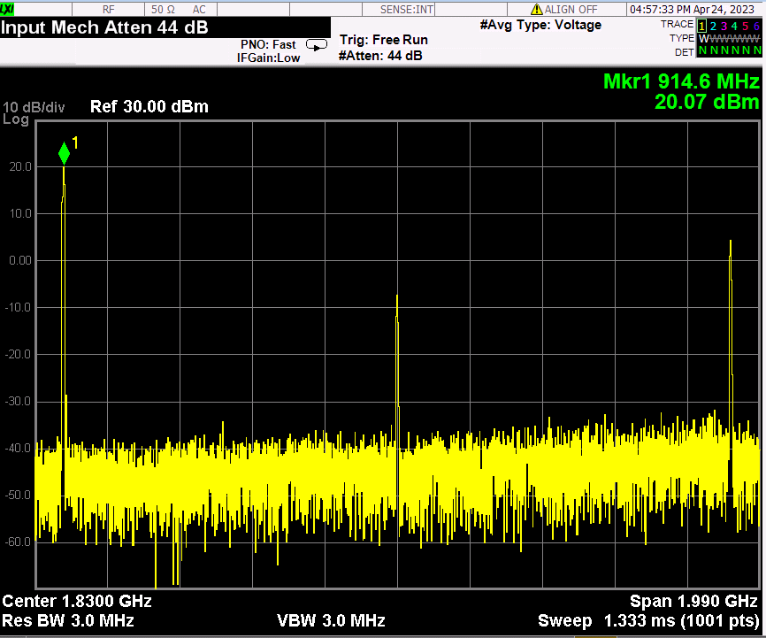
moRFeus generator(3.00dBm)+ PA(ZX60-V63+)

Slide 38
Future work
Link budget analysis : range vs. BER
RF Frontend + chanel model with Simulink for timing recovery simulation of baseband.
Rx/Tx chain integration and performance test.
Mixed signal part & FPGA interoperability test.
Troubleshooting for whole system operation.

Slide 39
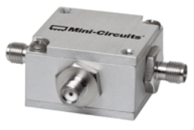
Mixer(ZFM-4H-S+): back up component
ZFM-4H-S+
low conversion loss, 4.97 dB typ.
good L-R isolation, 35 dB typ, L-I, 35 dB typ.
wideband, 5 to 1200 MHz
rugged shielded case

Slide 40
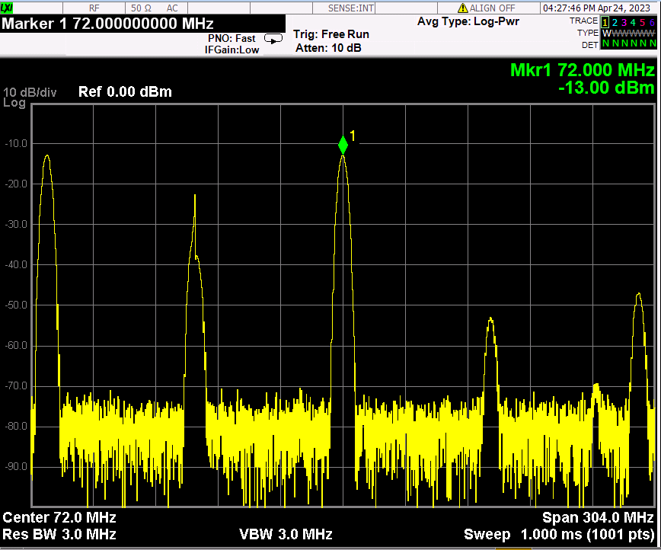
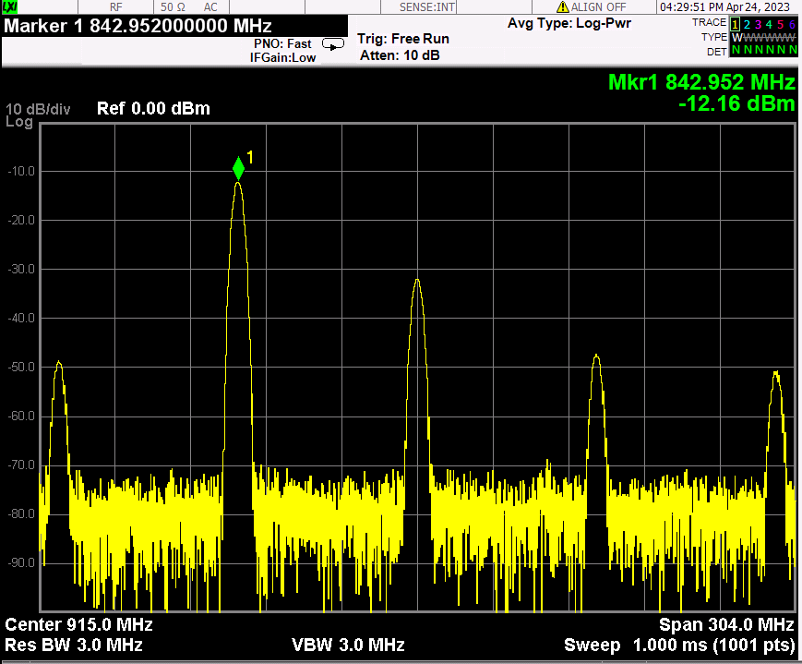
ZFM-4H-S+_I:843MHz(3dBm), L:915MHz(3dBm), R: out

Slide 41
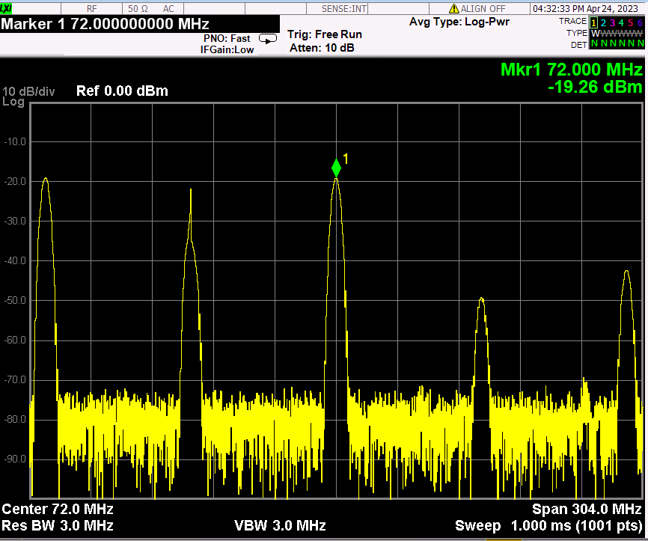
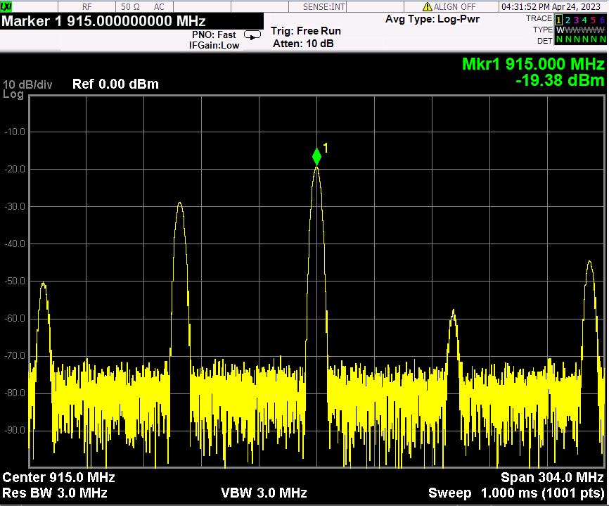
ZFM-4H-S+_I:915MHz(3dBm), L:843MHz(3dBm), R: out

Slide 42
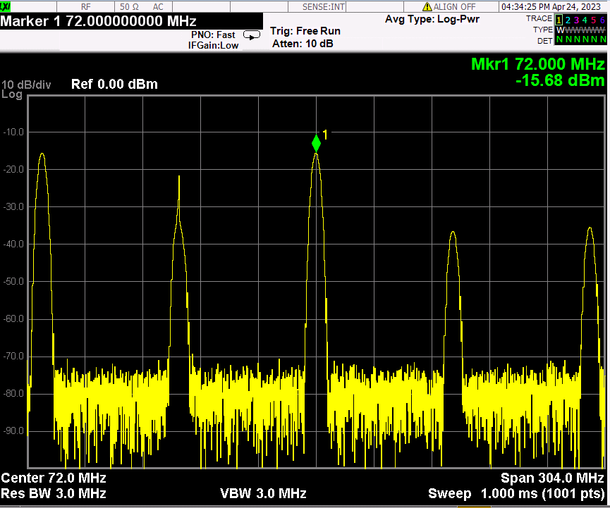
ZFM-4H-S+_I:915MHz(3dBm), L:out, R: 843MHz(3dBm)

Slide 43
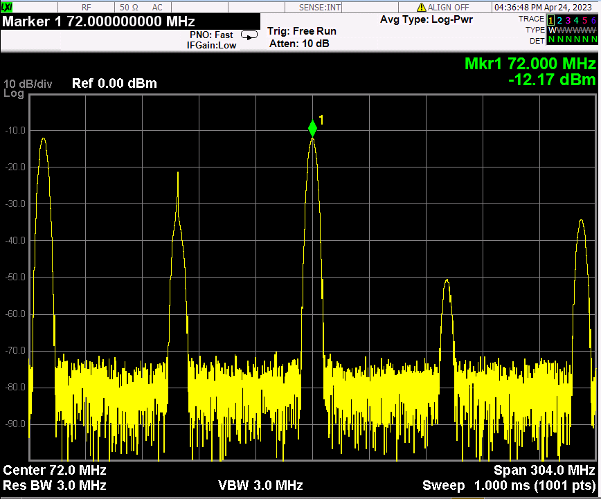
ZFM-4H-S+_I:out, L:915MHz(3dBm), R: 843MHz(3dBm)

Slide 44
802.15.4 Project RF Front End

Slide 45
RF Frontend + Mixed signal parts list

Slide 46
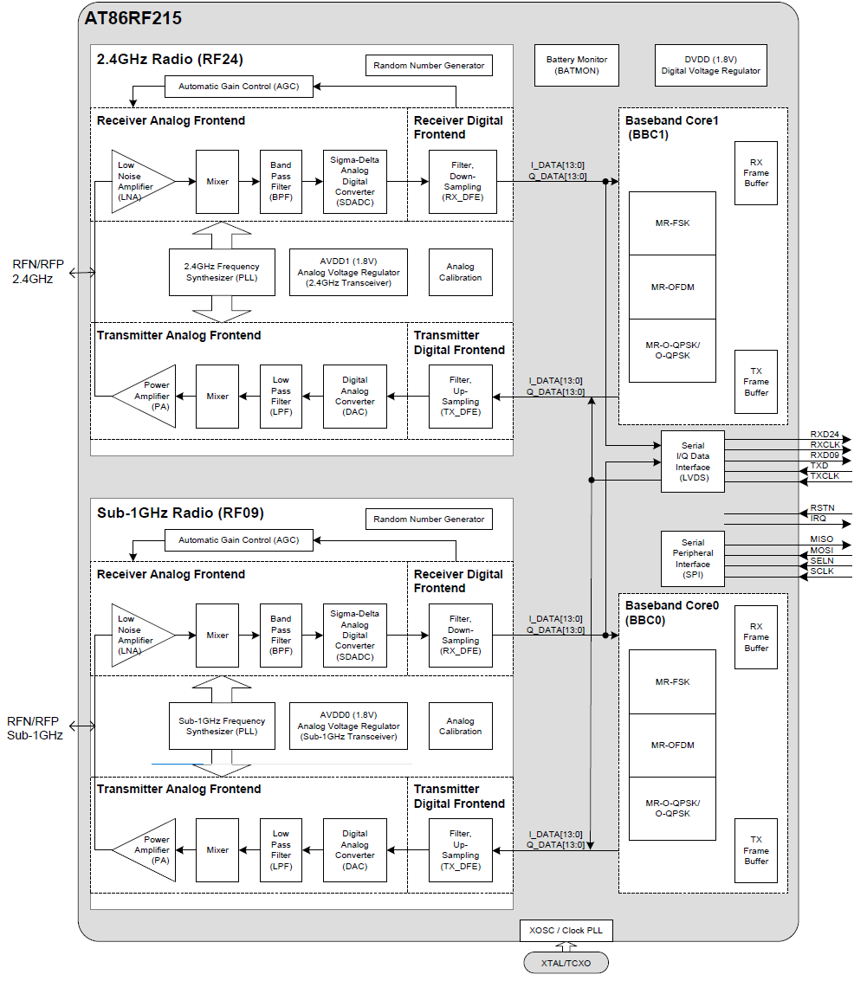
Block Diagram

Slide 47
RX

Slide 48
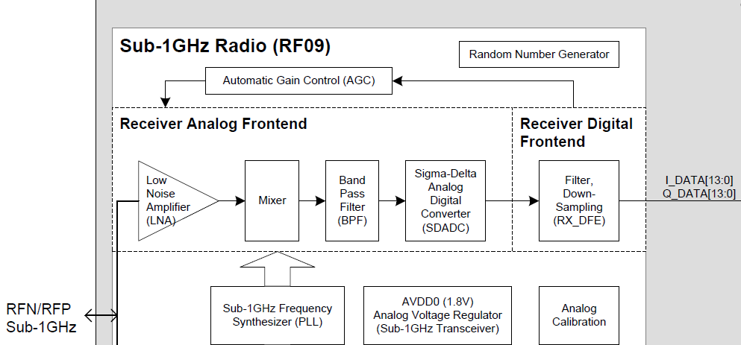

Slide 49
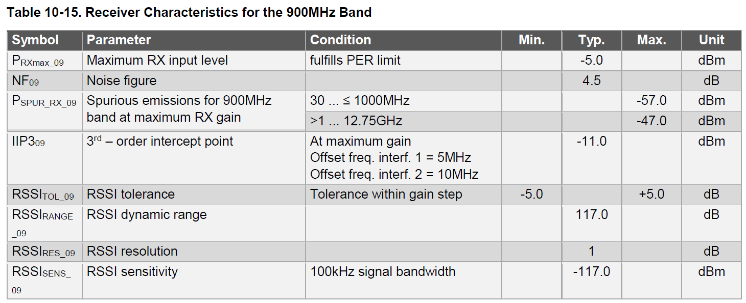
Rx RF BPF

Slide 50
<Required Eb/No (Energy per bit to Noise power density ratio) of the AT86RF215 transceiver >
: Packet Error Rate (PER) of less than 10% in MR-O-QPSK mode with a PSDU length of 20 octets, a PSDU data rate of 50 kbps and a 200 kHz chip rate
Bit rate = PSDU data rate / (8 x PSDU length)
= 50 kbps / (8 x 20) = 31.25 bps
Required BER to achieve PER < 10%:
BER = (PER / PSDU length)
= (0.1 / 20) = 0.005
By formula Eb/No = (Bit rate / Chip rate) x (log2(M) / BER),
Eb/No = (31.25 bps / 200 kHz) x (log2(4) / 0.005)
= 24.14 dB

Slide 51
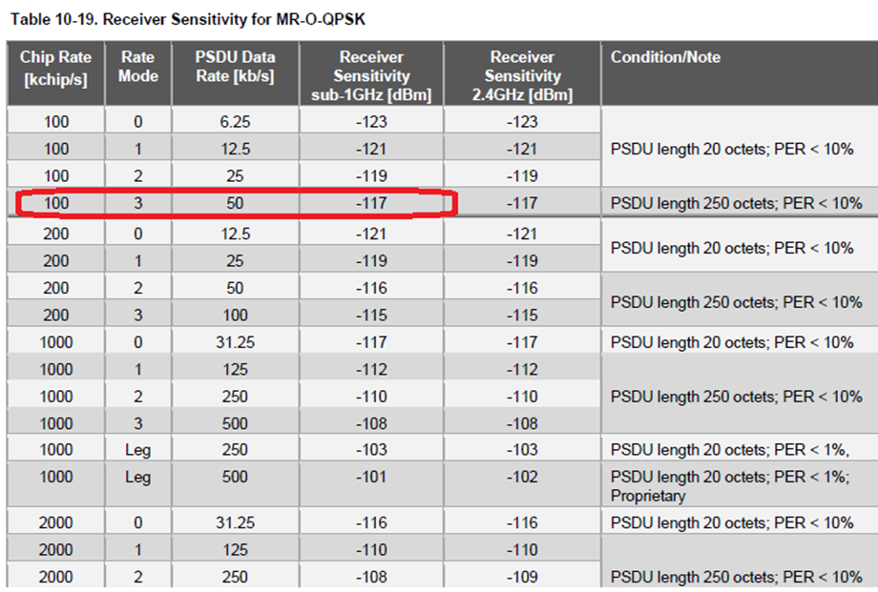
Reference sensitivity of AT86RF215

Slide 52
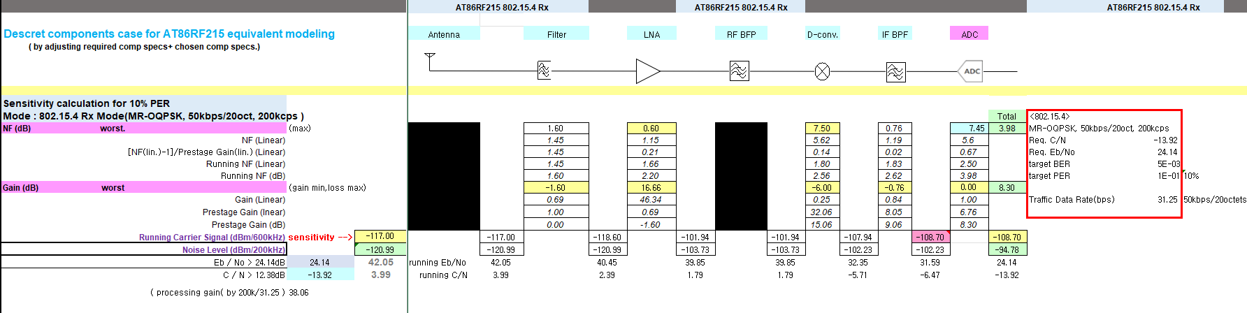
Discrete components case for AT86RF215 equivalent modeling
( by adjusting required comp specs+ chosen comp specs.)

Slide 53
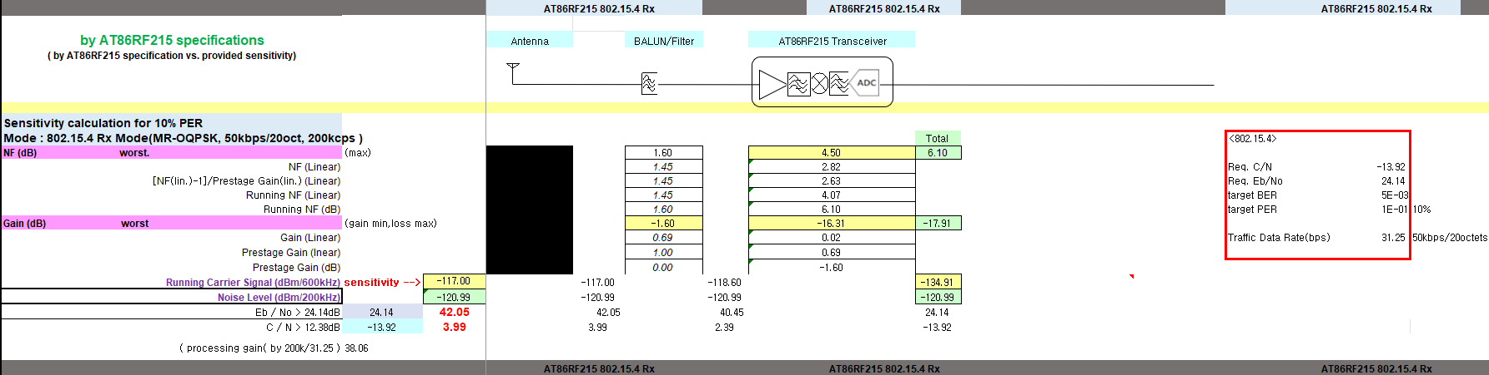
By AT86RF215 specifications
( by AT86RF215 specification vs. provided sensitivity)

Slide 54
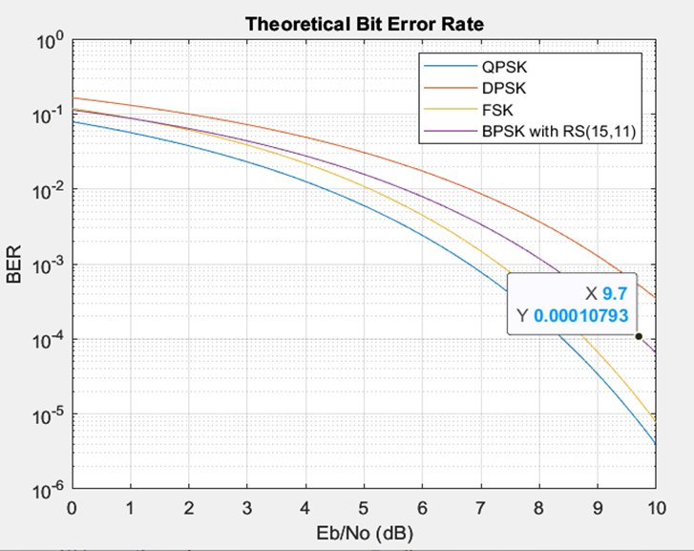
Required Eb/No for BPSK+ReedSolomon(15,11)
( assumed for link budget calculation target )

Slide 55

Discrete components model for AT86RF215 for our design

Slide 56

Discrete components case- improved by removing BPF

Slide 57

By AT86RF215 our design
( by AT86RF215 specification vs. provided sensitivity)

Slide 58

Cascaded calculation equivalent to AT86RF215
by required component specifications + ADC making the performance same to the AT86RF215 design

Slide 59

Cascaded calculation equivalent to AT86RF215
by required component specifications + ADC we can use

Slide 60
TX

Slide 61

Transmitter

Slide 62


Slide 63


Slide 64
Link Margin Calculation for the Distance
Transmitter Parameters:
Output Power (PTx): 11 dBm (~10 mW)
Trace Loss (Lc): 0.3 dB
Antenna Gain (Gt): 2.14 dBi
Receiver Parameters:
Receiver Sensitivity (PSens): -100.37 dBm
Trace Loss (Lc): 0.3 dB
Antenna Gain (Gr): 2.14 dBi
System Noise Figure (NF): 6.1 dB
Path Loss:
Frequency (f): 915 MHz
Distance (d): 350 meters
Transmitting Antenna Height (ht): 2 meters
Receiving Antenna Height (hr): 2 meters
Environment Factor (L): 0 dB
Calculation:
Path Loss (PL) = 20*log10(4*pi*d*f/c) + 20*log10(ht) + 20*log10(hr) + L = 20*log10(4*pi*350*915*10^6/(3*10^8)) + 20*log10(2) + 20*log10(2) + 0 = 94.6 dB
Total Transmit Power (PTx_total) = PTx + Gt - Lc = 10 + 2.14 - 1 = 12.14 dBm
Free Space Loss (FSL) = 20*log10(4*pi*d*f/c) = 20*log10(4*pi*350*915*10^6/(3*10^8)) = 82.6 dB
Received Power (PRx) = PTx_total + Gt + Gr - PL - Lc - L = 12.14 + 2.14 + 2.14 - 94.6 - 0.3 - 6.1 = –84.6 dBm
Signal-to-Noise Ratio (SNR) = PRx - PSens - NF = -84.6 - 6.1- (-100.37) = 9.67 dB
Link Margin (LM) = SNR - System Requirement = 9.67 - (9.7) = -0.03 dB
Based on this calculation, the link margin is -0.03 dB for 350m with BER 1E-4, which indicates that the link should have good reliability with profer margin for ~350m

Slide 65
Simulink Channel model
: can be replaced by just path loss
For 802.15.4, the bandwidth is relatively small; hence, the channel will tend to be non frequency selective (i.e well approximated by a single scaled delta function).
So there really isn’t anything fancy to do here for simulated channel models. So a simple line of sight path loss model would suffice.
—Patrick

Slide 66
Future work
Link budget analysis : range vs. BER
RF Frontend + chanel model with Simulink for timing recovery simulation of baseband.
Rx/Tx chain integration and performance test.
: LVDS connector is required to thest I/Q radio mode vis LVDS interface.
Mixed signal part & FPGA interoperability test.
: FPGA is got delayed to be ready.
Troubleshooting for whole system operation.

Slide 67

RXDCLK of LVDS interface

